Slide 1
Tutorial of downloading and processing RNAseq data for FungiExpresZ with snakemake

Slide 2
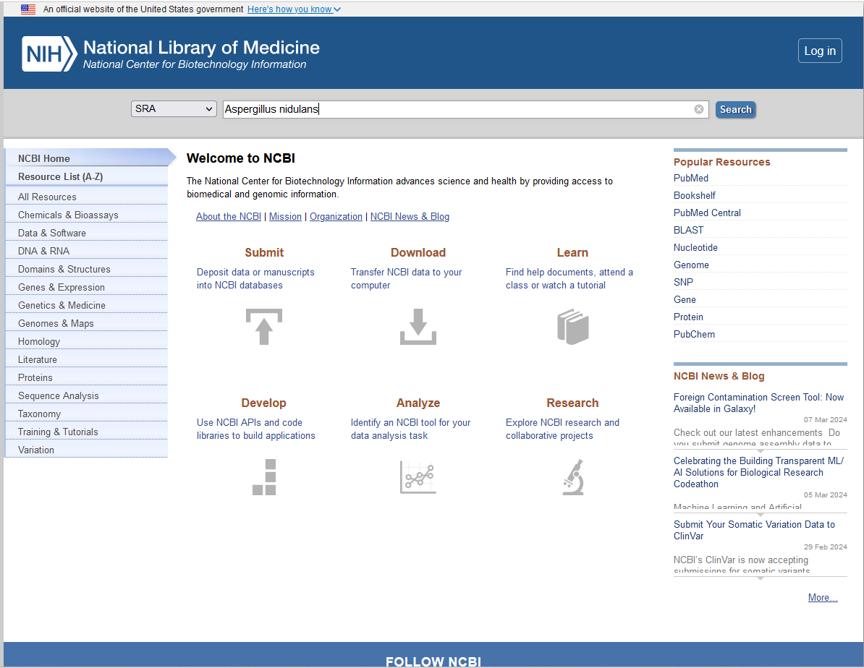
https://www.ncbi.nlm.nih.gov/

Slide 3
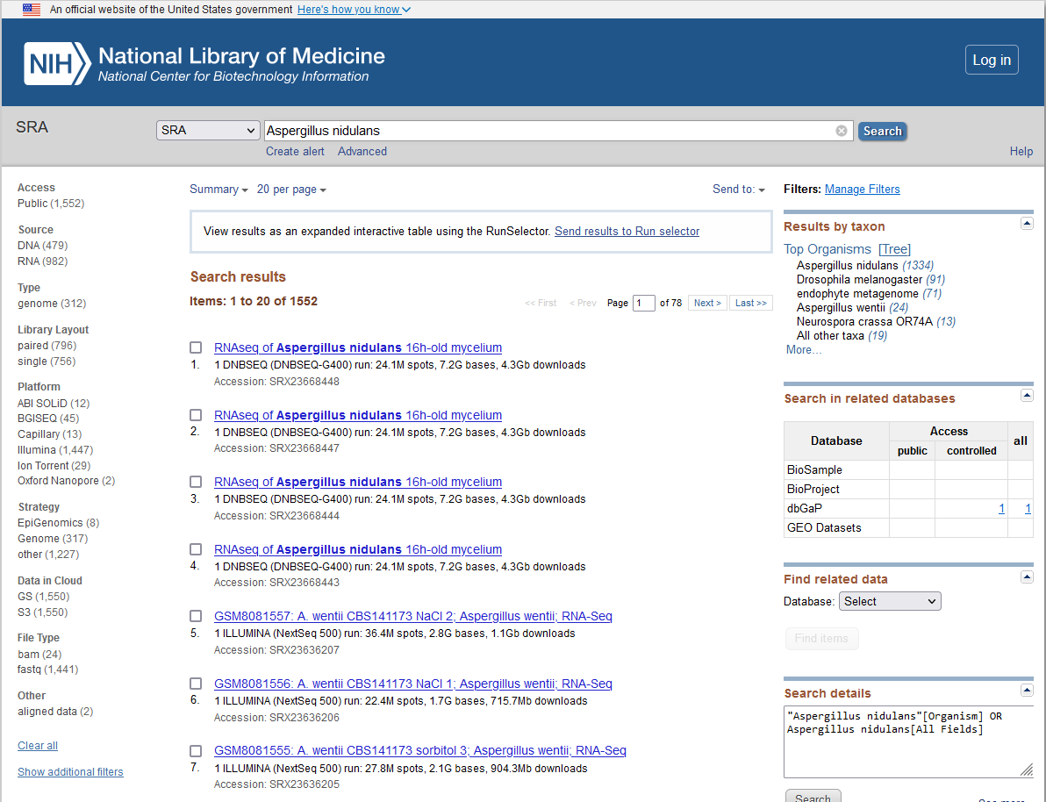

Slide 4
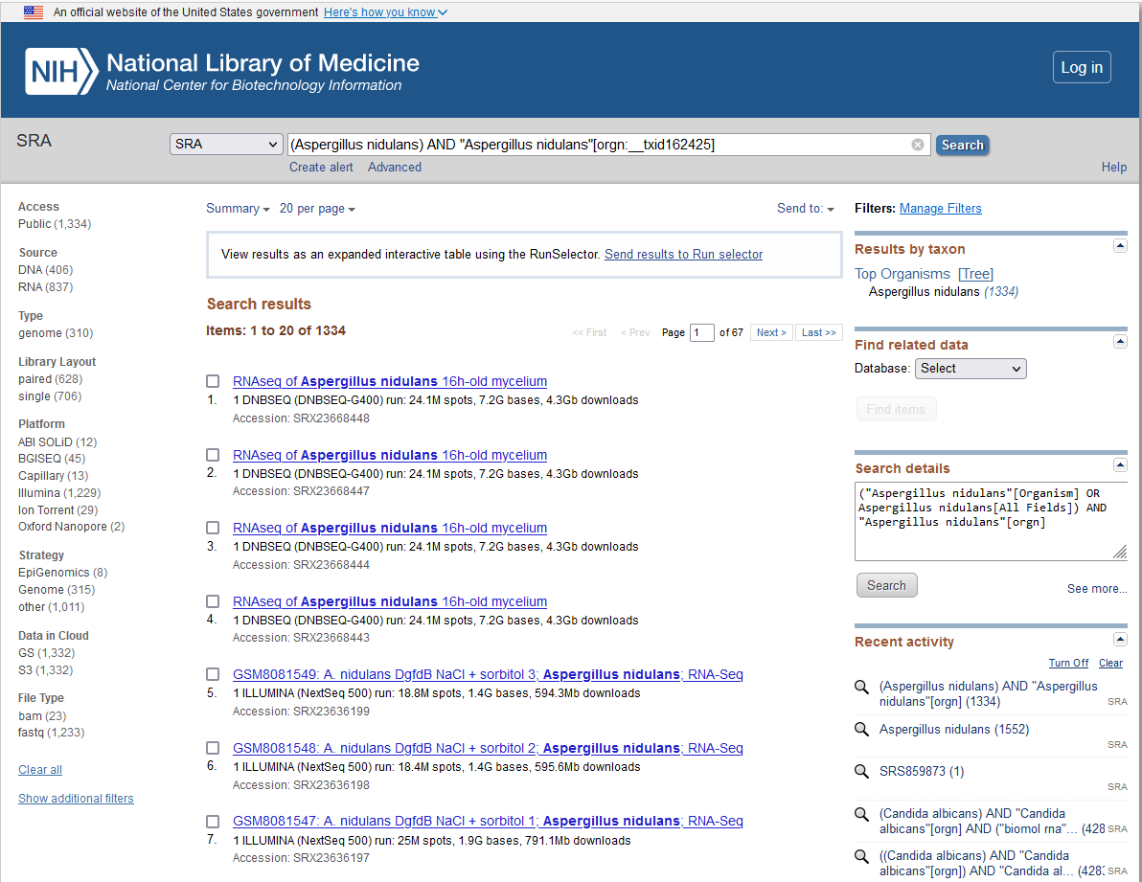

Slide 5
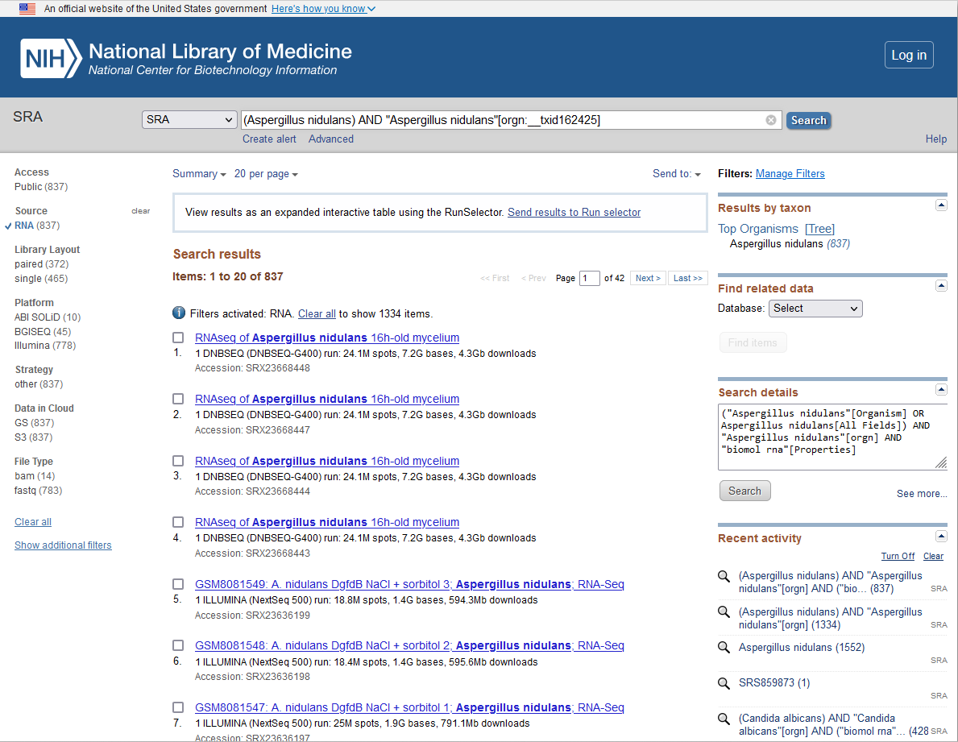

Slide 6
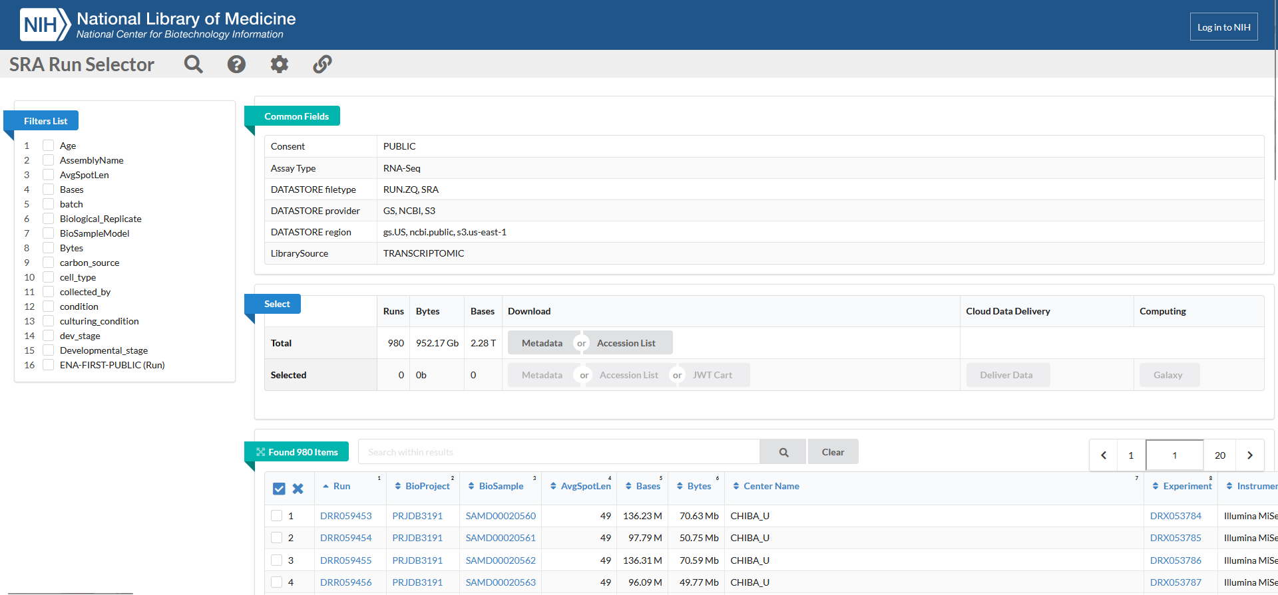

Slide 7
Open the SraRunTable.txt with excel
Select ColumnA
Click Data
Click Text to Columns
Click Delimited
Click next
Click Comma
Click Next
Click Finish

Slide 8
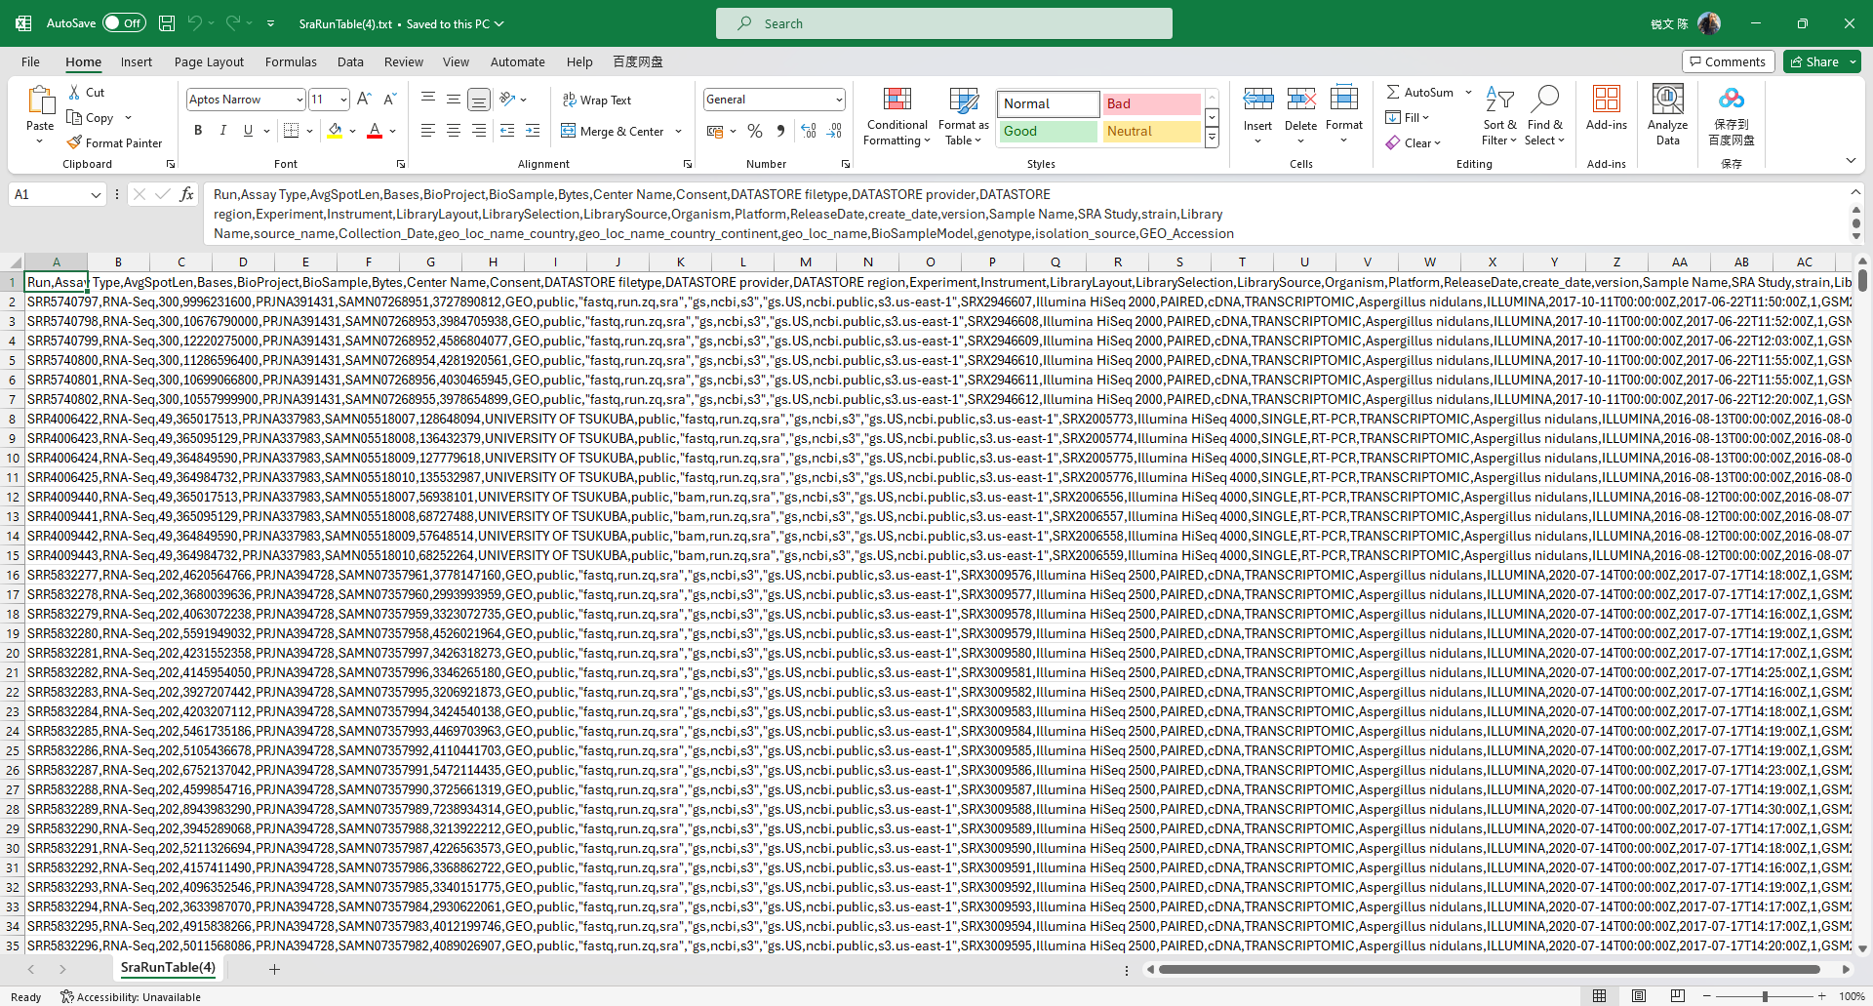

Slide 9
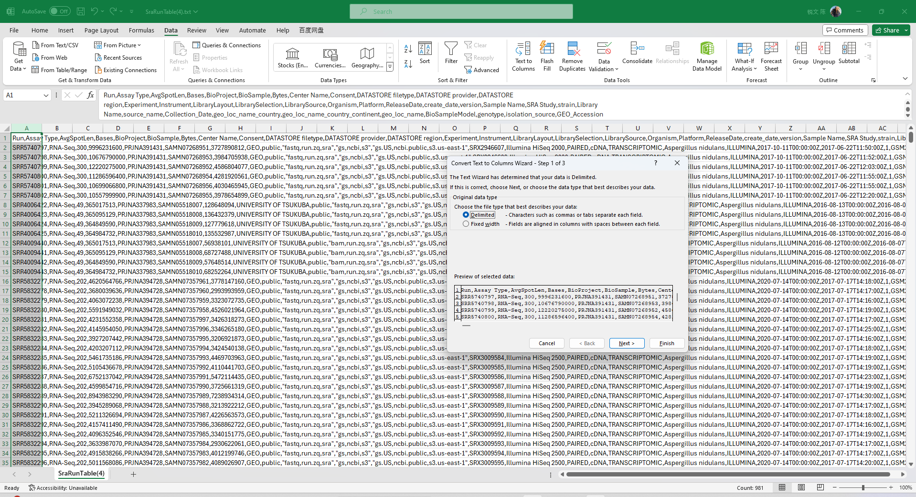
2
3
1
4
5

Slide 10
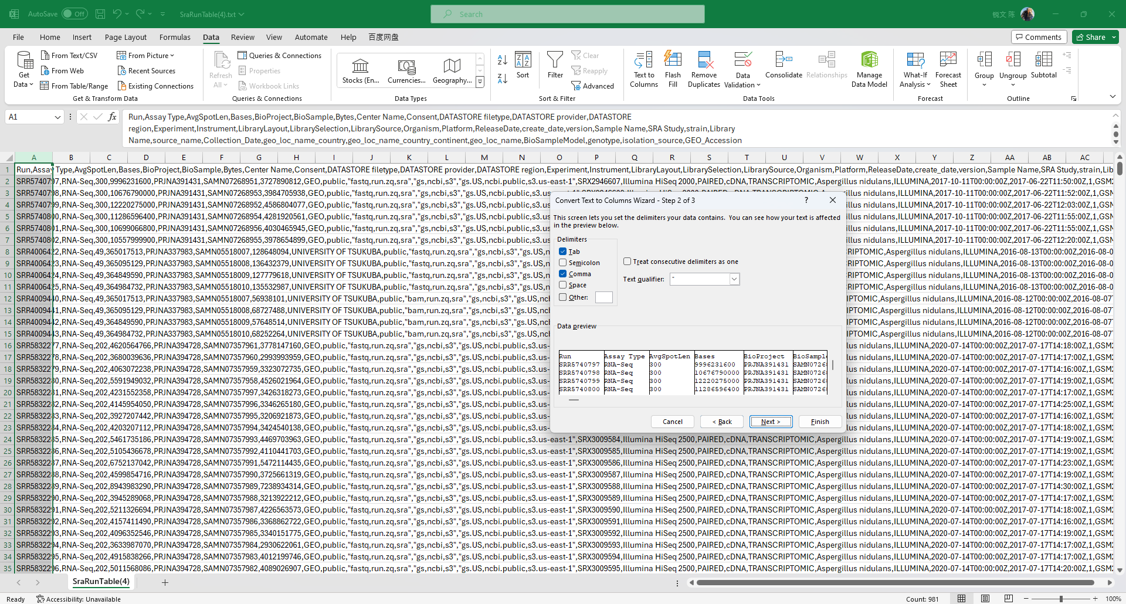
6
7
8

Slide 11
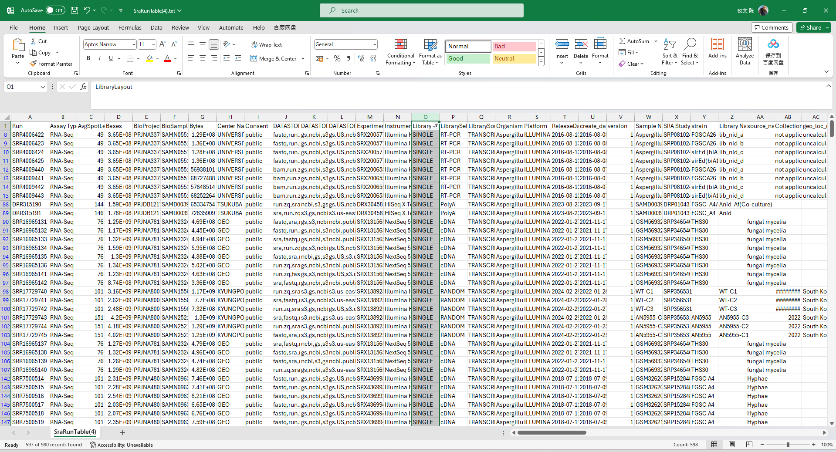
Column O represents "LibraryLayOut," which indicates whether the sample is single-end or paired-end sequencing.
Column A contains the "Run number" information, which is used to download the corresponding RNAseq data.

Slide 12
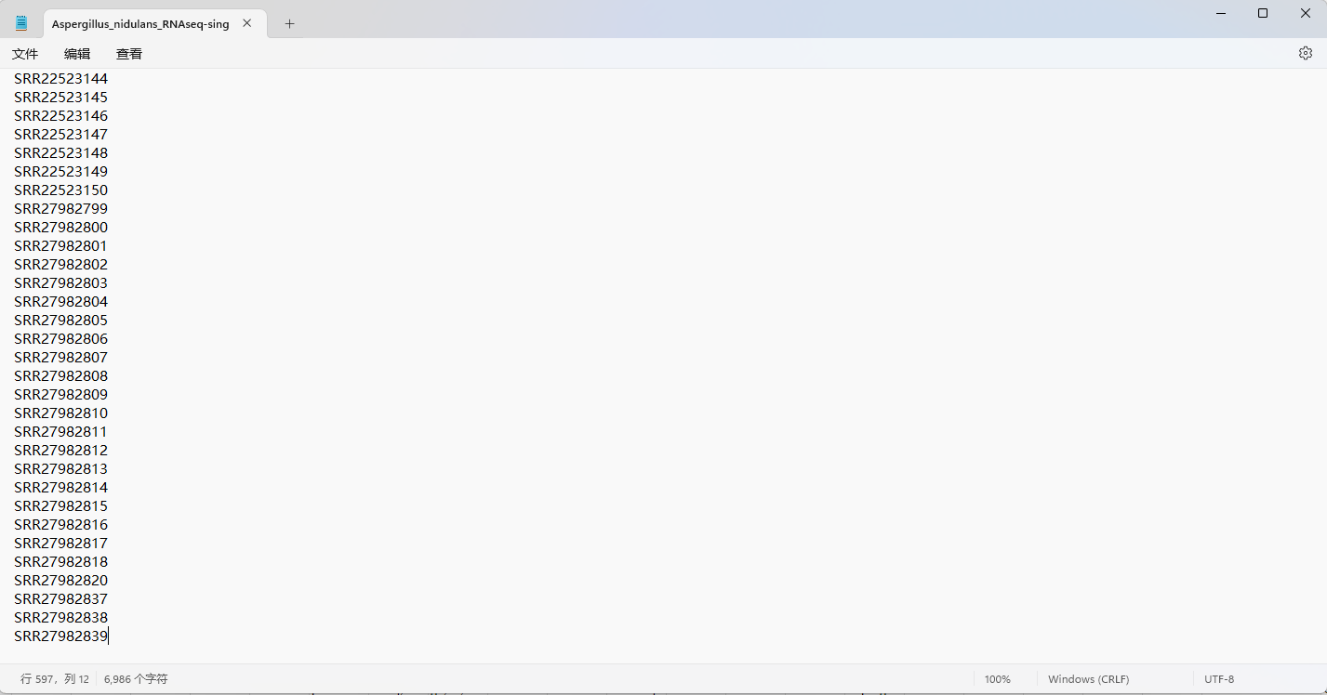

Copy the Run numbers of single-end and paired-end to two different txt files.
The code for single end and paired end is different. (FungiExpresZ_single_end.py or FungiExpresZ_paired_end.py)

Slide 13
To download and processing the RNAseq data, you should download and install the following tools / software:
SRA Toolkit (prefetch and fasterq-dump)
hisat2
stringtie
samtools
snakemake

Slide 14
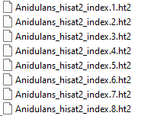
Genome files of most species can be downloaded from Fungidb
Download the .fasta file and .gff file
Using hisat2-build command to build the index file.
e.g. hisat2-build FungiDB-65_AnidulansFGSCA4_Genome.fasta Anidulans_hisat2_index

Slide 15
prefetch
Download data according to the SRR number
fastq-dump
(.fastq)
hisat2 mapping
(.bam)
stringtie calculate FPKM (.xls)
samtools flagstat get mapping rate (_alignmentstat)

Slide 16
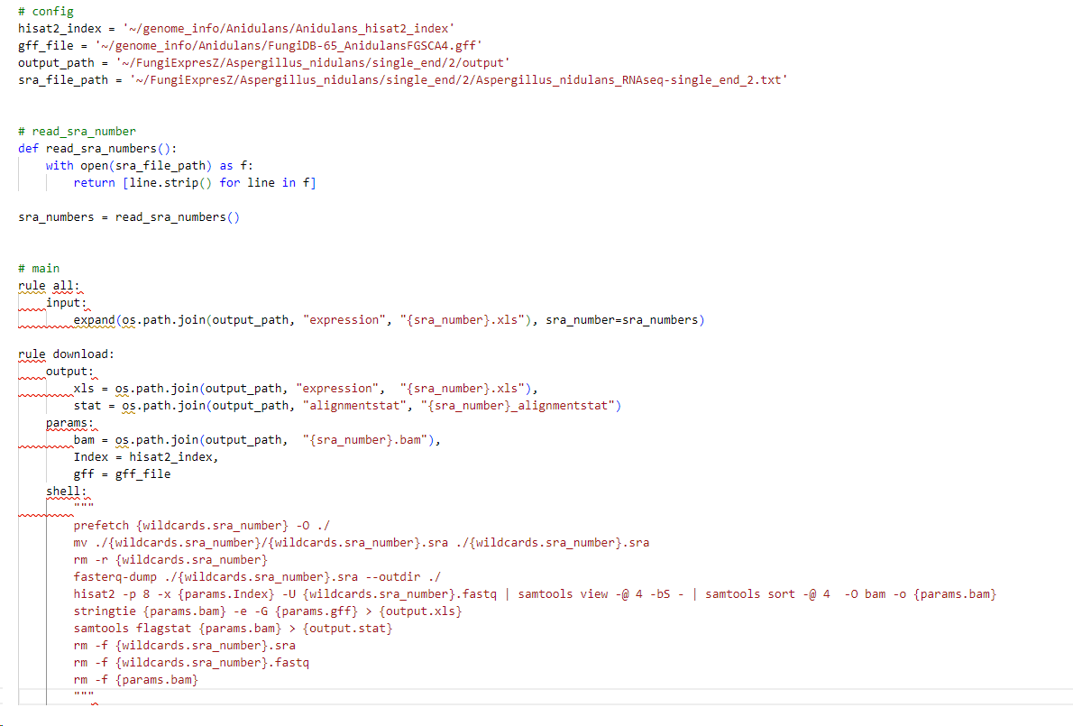
change the path to your file in snakefile (FungiExpresZ_single_end.py or FungiExpresZ_paired_end.py)
output_path is where you store the result
Paired end and single end are two different snakefiles

Slide 17
If too many RNAseq data for a species, you can separate the data into serval files.

Slide 18
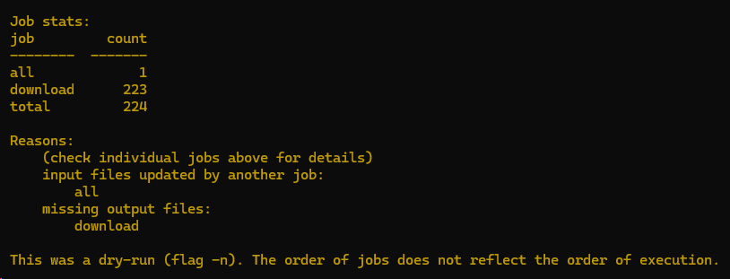
Before running the snakefile, you should use --dryrun to see there is an error or not.
e.g. snakemake –s FungiExpresZ_single_end.py --dryrun
If there is no error, you will see the Job stats, such as the figure
Run the snakefile to get the FPKM and alignmentstat e.g. snakemake -s FungiExpresZ_single_end.py --cores 4 --latency-wait 10 --keep-going --rerun-incomplete
You can provide more cores to run faster.

Slide 19
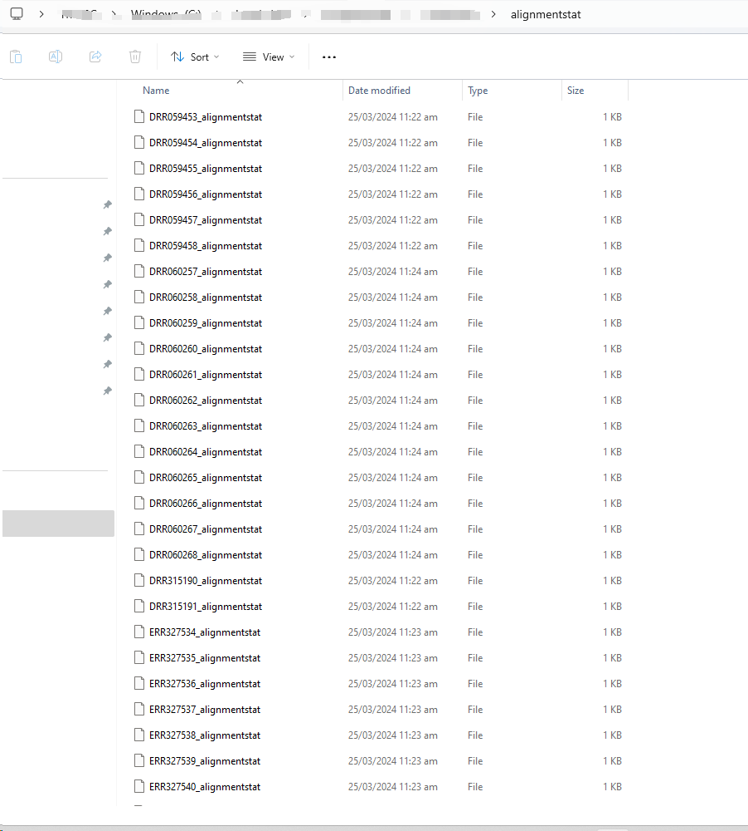
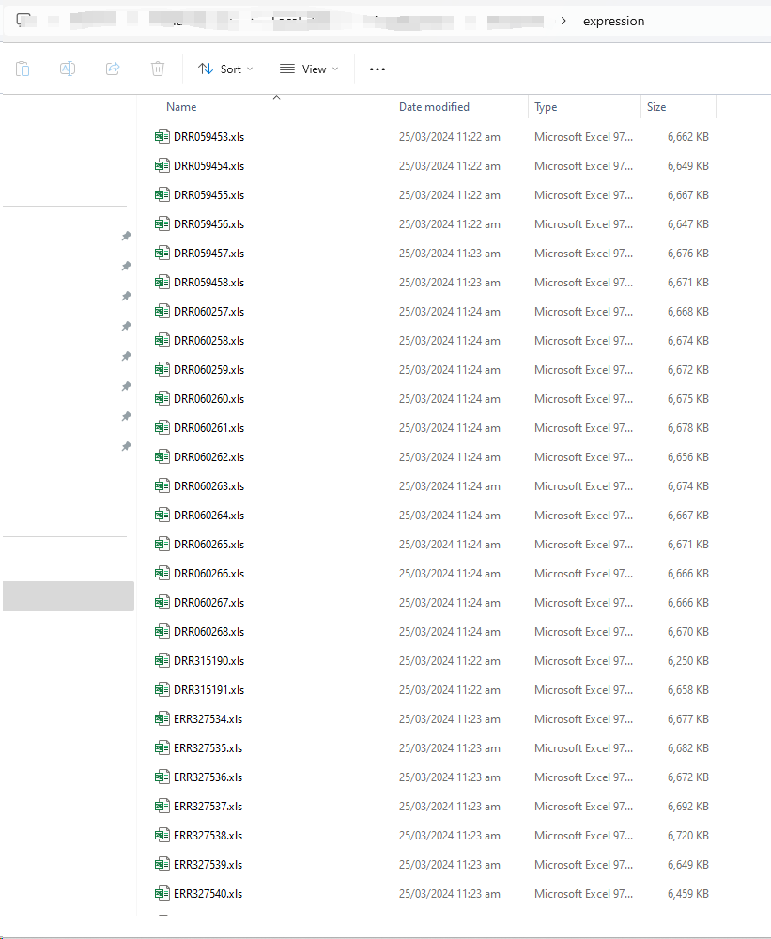

After completing the Snakemake process, organize the resulting files by moving all the 'sample_alignmentstat' files into one folder and all the 'sample.xls' files into another folder. (including both single and paired end)
Merge the FPKM values of each sample into a matrix using the Python script expression_matrix.py. (pandas package is required) e.g. python expression_matrix.py -alignmentstat_path alignmentstat -stringtie_path expression

Slide 20

After the script finishes running, you will obtain the following two files.
The file 'alignment.xlsx' includes the alignment stat for all samples.
The 'expression_matrix.tsv' file contains the samples that meet the criteria of having a mapping rate above the specified threshold and a mapped reads count exceeding the specified threshold.
The threshold values can be set in the Python script.

